Slide 1
Self Driving Car(Robot) (A Beta Version)
Anshu Pandey
II Year M.E. (ACR)
Faculty of Technology & Engineering
The Maharaja Sayajirao University of Baroda

Slide 2
Self Driving Robot
Standard Robot
Create Data
Train a ANN Algorithm
ANN Driving the Robot
Test the Algorithm

Slide 3
In this work I have tried to design a self driving robot using camera data analysis.
Initially a manualy controlled machine is designed which can be controlled over Bluetooth from PC.
Interfacing it with Python, and using smartphone camera data is collected whenever the user takes the robot into different direction according to the environmental conditions and the python codes collects data in terms of images for every condition and names them as the direction taken by images.
In simple word, the user is driving a manual car and the python code is taking the snapshot of every condition for which user is taking decision and also saving those snapshot with the name of decisions so that we will have proper training data. E.g. If user is taking Robot forward, python code will save that snapshot with forward_01.jpg.

Slide 4
After Collection of Data, a Multilayer feedforward Neural Network is trained using the data, images are compressed upto 25x25 pixel to efficient training.
The Neural Network is also tested on some test data to check its efficiency, At this point more better work is to be done.
The Trained model is saved in local machine ( computer).
Again integrating the smartphone camera with python code, taking live images from the Robot using trained model we are making the model to predict the real time direction which Robot should Take and that the final work done till now.

Slide 5
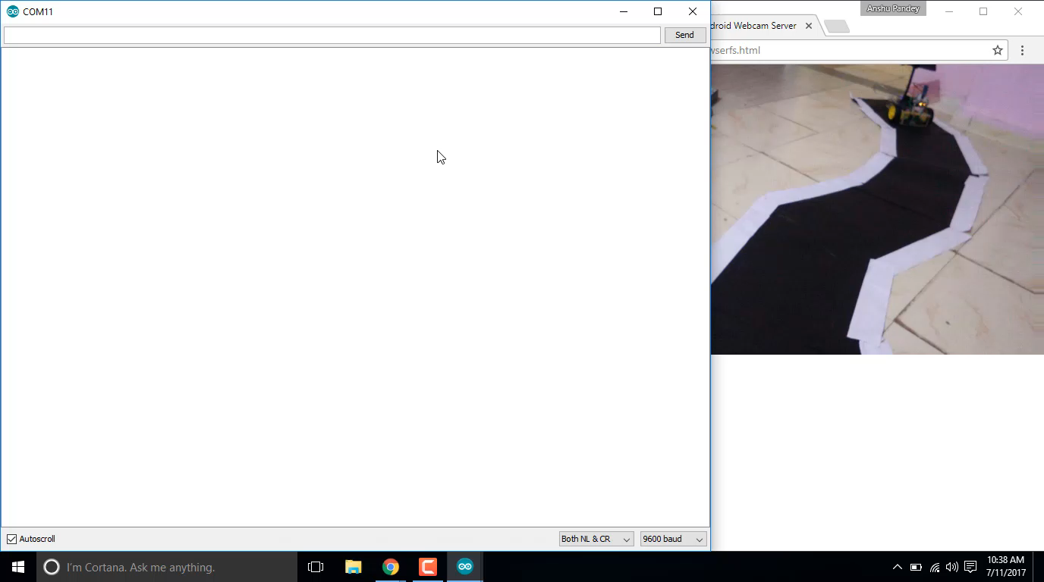
A Manual Robot controlled from Python

Slide 6
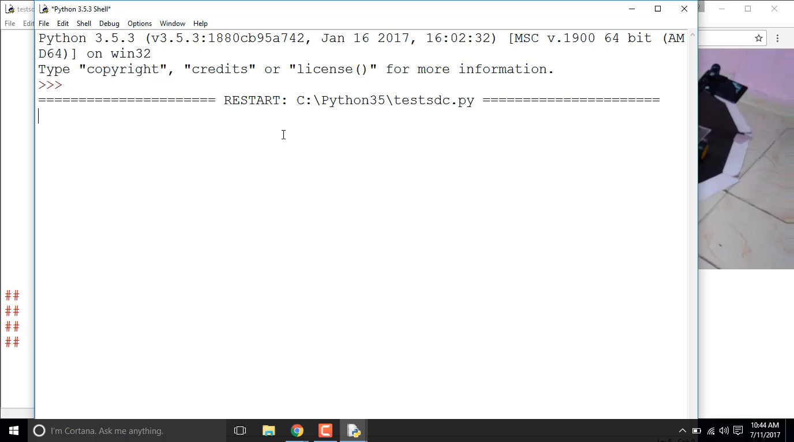
Collecting Data using Python

Slide 7
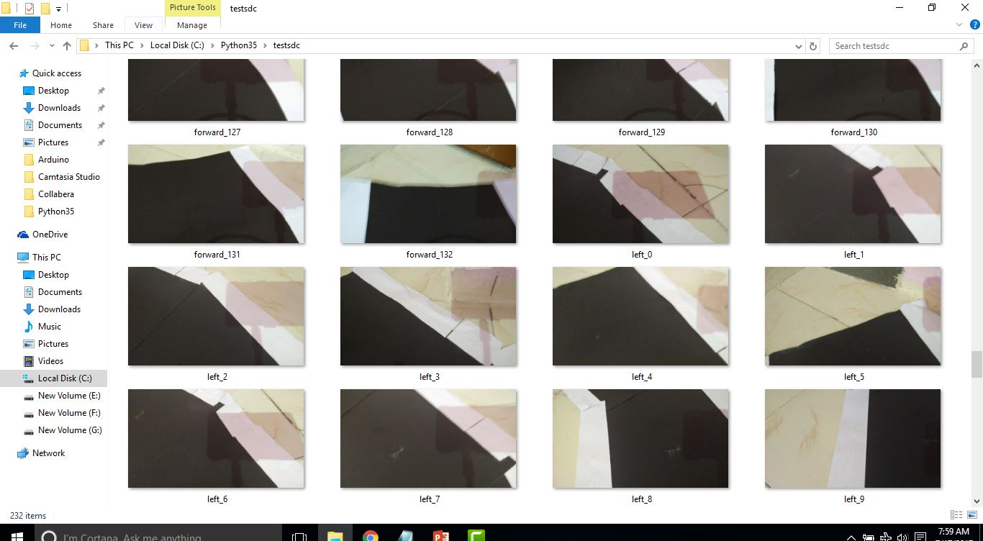
Collected Data

Slide 8
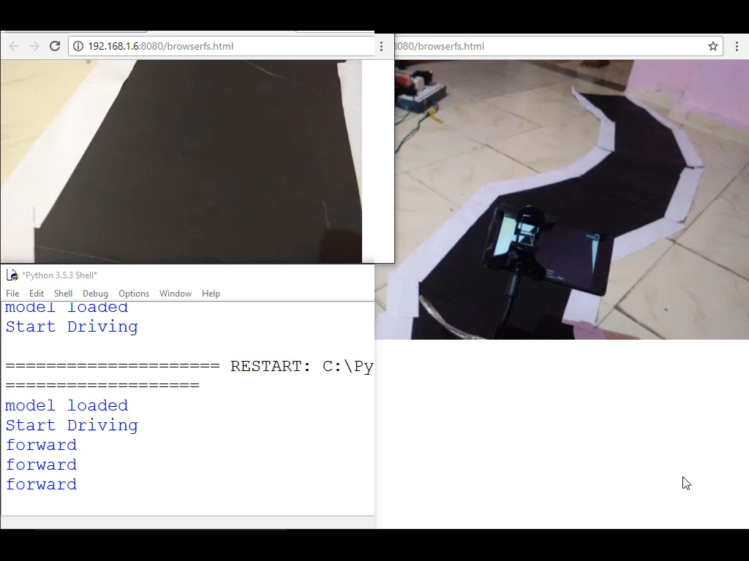
ANN Driving Robot After Training

